Slide 1
TOPICS
MANAGEMENT SKILLS.
REWARD AND CHALLENGES.
CRITICAL REVIEW OF MANAGEMENT.
UNIVERSAL NEED OF MANAGEMENT.
TECHNOLOGICAL CHANGES EFFECTING MANAGERS.
EARLY ADVOCATES OF OB.
FAYOLS 14 PRINCIPLES.

Slide 2
REWARDS AND CHALLENGES OF BEING A MANAGER
There are many challenges. It can be a tough and often thankless job. In addition, a portion of a manager’s job (especially at lower organizational levels) may entail duties that are often more clerical (compiling and filing reports, dealing with bureaucratic procedures, or doing paperwork) than managerial.41 Managers often have to deal with a variety of personalities and have to make do with limited resources. It can be a challenge to motivate workers in the face of uncertainty and chaos, as this recession has illustrated time and time again. And managers may find it difficult to successfully blend the knowledge, skills, ambitions, and experiences of a diverse work group. Finally, as a manager, you’re not in full control of your destiny. Your success typically is dependent upon others’ work performance.
Despite these challenges, being a manager can be rewarding. You’re responsible for creating a work environment in which organizational members can do their work to the best of their ability and thus help the organization achieve its goals. You help others find meaning and fulfillment in their work. Other rewards may include receiving recognition and status in your organization and in the community, playing a role in influencing organizational outcomes, and receiving attractive compensation in the form of salaries, bonuses, and stock options.

Slide 3
REWARDS AND CHALLENGES OF BEING A MANAGER
REWARDS | CHALLENGES
Create a work environment in which organizational members can work to the best of their ability. | Do hard work
Have opportunities to think creatively and use imagination. | May have duties that are more clerical than managerial.
Help others find meaning and fulfillment in work. | Have to deal with a variety of personalities.
Support, coach, and nurture others | Often have to make do with limited resources.
Work with a variety of people | Motivate workers in chaotic and uncertain Situations.
Receive recognition and status in organization and community. | Blend knowledge, skills, ambitions, and experiences of a diverse work group
Play a role in influencing organizational Outcomes. | Success depends on others’ work Performance.
Receive appropriate compensation in the form of salaries, bonuses, and stock options
Good managers are needed by organizations

Slide 4
FAYOL’S FOURTEEN PRINCIPLES
Fayol described the practice of management as something distinct from accounting, finance, production, distribution, and other typical business functions. His belief that management was an activity common to all business endeavors, government, and even the home led him to develop 14 principles of management—fundamental rules of management that could be applied to all organizational situations and taught in schools. These principles are shown as follows:
1. DIVISION OF WORK: Specialization increases output by making employees more efficient.
2. AUTHORITY : Managers must be able to give orders, and authority gives them this right.
3. DISCIPLINE : Employees must obey and respect the rules that govern the organization.
4. UNITY OF COMMAND : Every employee should receive orders from only one superior.
5. UNITY OF DIRECTION :The organization should have a single plan of action to guide managers and workers.
SUBORDINATION OF INDIVIDUAL INTERESTS TO THE GENERAL INTEREST : The interests of any one employee or group of employees should not take precedence over the interests of the organization as a whole.
7. REMUNERATION : Workers must be paid a fair wage for their services.
8. CENTRALIZATION : This term refers to the degree to which subordinates are involved in
decision making

Slide 5
FAYOL’S FOURTEEN PRINCIPLES
9. SCALAR CHAIN :The line of authority from top management to the lowest ranks is the
scalar chain.
10. ORDER :People and materials should be in the right place at the right time.
11. EQUITY : Managers should be kind and fair to their subordinates.
12. STABILITY OF TENURE OF PERSONNEL : Management should provide orderly personnel planning
and ensure that replacements are available to fill vacancies.
13. INITIATIVE : Employees who are allowed to originate and carry out plans will exert high
levels of effort.
14. ESPRIT DE CORPS : Promoting team spirit will build harmony and unity within the organization.

Slide 6
UNIVERSAL NEED OF MANAGEMENT
Just how universal is the need for management in organizations. We can say with absolute certainty that management is needed in all types and sizes of organizations, at all organizational levels and in all organizational work areas, and in all organizations, no matter where they’re located. This is known as the universality of management.
Management Is needed in. all types of organizations either profit or non profitable organizations. It is also needed in all sizes of organizations either small or large, all levels of organizations either bottom or top and at All organizational areas including Manufacturing, Marketing, Human resources, Accounting and Information system .
In all these organizations, managers must plan, organize, lead, and control. However, that’s not to say that management is done the same way. What a supervisor in a software applications testing group at Microsoft does versus what the CEO of Microsoft does is a matter of degree and emphasis, not of function. Because both are managers, both will plan, organize, lead, and control. How much and how they do so will differ, however. Management is universally needed in all organizations, so we want to find ways to improve the way organizations are managed . Because we interact with organizations every single day. Are you frustrated when you have to spend two hours in a state government office to get your driver’s license renewed? Are you irritated when none of the sales people in a retail store seems interested in helping you? These examples show problems created by poor management. Organizations that are well managed—and we’ll share many examples of these throughout the text— develop a loyal customer base, grow, and prosper, even during challenging times. Those that are poorly managed find themselves losing customers and revenues. By studying management, you’ll be able to recognize poor management and work to get it corrected. In addition, you’ll be able to recognize and support good management, whether it’s in an organization with which you’re simply interacting or whether it’s in an organization in which you’re employed.

Slide 7
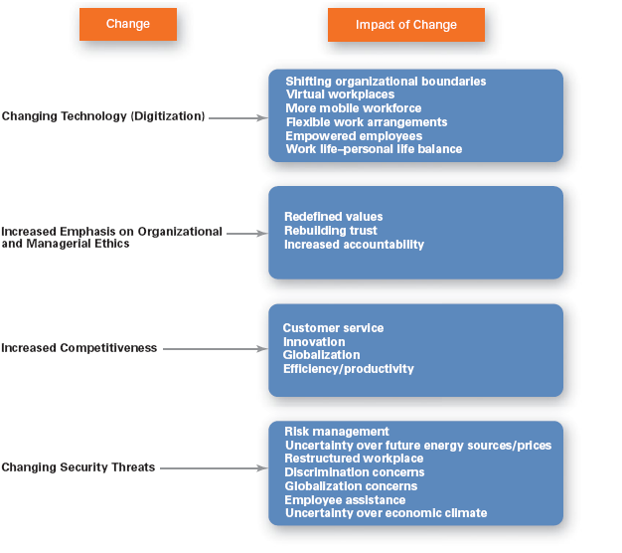
TECHNICAL CHANGES EFFECTING MANAGERS
In today’s world, managers are dealing with global economic and political uncertainties, changing workplaces, ethical issues, security threats, and changing technology. For example, Dave Maney, the top manager of Headwaters MB, a Denver-based investment bank, had to fashion a new game plan during the recession.
These are the some of the most important
Changes facing managers. We’ll be discussing
these and other changes and how they’re
affecting the way managers plan, organize,
lead, and control. We want to highlight
three of these changes: the increasing
importance of customers, innovation,
and sustainability

Slide 8
TECHNICAL CHANGES EFFECTING MANAGERS
Importance of Customers to the Manager’s Job
John Chambers, CEO of Cisco Systems, likes to listen to voice mails forwarded to him from dissatisfied customers. He says, “E-mail would be more efficient, but I want to hear the emotion, I want to hear the frustration, I want to hear the caller’s level of comfort with the strategy we’re employing. I can’t get that through e-mail. This manager understands the importance of customers. You need customers. Without them, most organizations would cease to exist. Yet, focusing on the customer has long been thought to be the responsibility of marketing types. “Let the marketers worry about the customers” is how many managers felt. We’re discovering, however, that employee attitudes and behaviors play a big role in customer satisfaction. Managers are recognizing that delivering consistent high-quality customer service is essential for survival and success in today’s competitive environment and that employees are an important part of that equation. The implication is clear—managers must create a customer-responsive organization where employees are friendly and courteous, accessible, knowledgeable, prompt in responding to customer needs, and willing to do what’s necessary to please the customer

Slide 9
Importance of Innovation to the Manager’s Job
Nothing is more risky than not innovating . Innovation means doing things differently, exploring new territory, and taking risks. And innovation isn’t just for high-tech or other technologically sophisticated organizations. Innovative efforts can be found in all types of organizations. For instance, the manager of the Best Buy store in Manchester, Connecticut, clearly understood the importance of getting employees to be innovative, a task made particularly challenging because the average Best Buy store is often staffed by young adults in their first or second jobs. Innovation is critical throughout all levels and parts of an organization. For example, at Tata of India, the company’s top manager, chairman Ratan Tata, told his employees during the bleak aspects of the global economic downturn to “Cut costs. Think out of the box. Even if the world around you is collapsing, be bold, be daring, think big.”37 And his employees obviously got the message. The company’s introduction of the $2,000 minicar, the Nano, was the talk of the global automotive industry. As these stories illustrate, innovation is critical. It’s so critical to today’s organizations and managers.
Importance of Sustainability to the Manager’s Job:
Sustainability means different things to different people, in essence, according to the World Business Council for Sustainable Development (2005), it is concerned with “meeting the needs of people today without compromising the ability of future generations to meet their own needs.” From a business perspective, sustainability has been defined as a company’s ability to achieve its business goals and increase long-term shareholder value by integrating economic, environmental, and social opportunities into its business strategies.40 Sustainability issues are now moving up the agenda of business leaders and the boards of thousands of companies. Like the managers at Walmart are discovering, running an organization in a more sustainable way will mean that managers have to make informed business decisions based on thorough communication with various stakeholders, understanding their requirements, and starting to factor economic, environmental, and social aspects into how they pursue their business goals.

Slide 10
CONCLUSION
The changes impacting managers’ jobs include global economic and political uncertainties, changing workplaces, ethical issues, security threats, and changing technology. Managers must be concerned with customer service because employee attitudes and behaviors play a big role in customer satisfaction. Managers must also be concerned with innovation because it is important for organizations to be competitive. And finally, managers must be concerned with sustainability as business goals are developed.

Slide 11
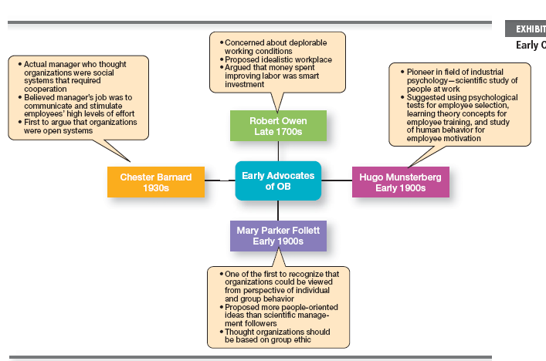
EARLY ADVOCATES OF OB

Slide 12
EARLY ADVOCATES OF OB
Although a number of individuals in the early twentieth century recognized the importance of people to an organization’s success, four stand out as early advocates of the OB approach. Robert Owen, Hugo Munsterberg, Mary Parker Follett, and Chester Barnard. Their contributions were varied and distinct, yet all believed that people were the most important asset of the organization and should be managed accordingly. Their ideas provided the foundation for such management practices as employee selection procedures, motivation programs, and work teams. The upper given chart summarizes each individual’s most important ideas. Without question, the most important contribution to the OB field came out of the Hawthorne Studies, a series of studies conducted at the Western Electric Company Works in Cicero, Illinois. These studies, which started in 1924, were initially designed by Western Electric industrial engineers as a scientific management experiment. They wanted to examine the effect of various lighting levels on worker productivity. They found that as the level of light was increased in the experimental group, output for both groups increased. Then, much to the surprise of the engineers, as the light level was decreased in the experimental group, productivity continued to increase in both groups. In fact, a productivity decrease was observed in the experimental group only when the level of light was reduced to that of a moonlit night. What would explain these unexpected results? The engineers weren’t sure, but concluded that lighting intensity was not directly related to group productivity, and that something else must have contributed to the results. They weren’t able to pinpoint what that “something else” was, though.
Countinue!!!!!!!!!!!!!!!!!

Slide 13
EARLY ADVOCATES OF OB (continue)
In 1927, the Western Electric engineers asked Harvard professor Elton Mayo and his associates to join the study as consultants. Thus began a relationship that would last through 1932 and encompass numerous experiments in the redesign of jobs, changes in workday and workweek length, introduction of rest periods, and individual versus group wage plans. The results indicated that the incentive plan had less effect on a worker’s output than did group pressure, acceptance, and security. The researchers concluded that social norms or group standards were the key determinants of individual work behavior. Scholars generally agree that the Hawthorne Studies had a game-changing impact on management beliefs about the role of people in organizations. Mayo concluded that people’s behavior and attitudes are closely related, that group factors significantly affect individual behavior, that group standards establish individual worker output, and that money is less a factor in determining output than are group standards, group attitudes, and security. These conclusions led to a new emphasis on the human behavior factor in the management of organizations . Although critics attacked the research procedures, analyses of findings, and conclusions, it’s of little importance from a historical perspective whether the Hawthorne Studies were academically sound or their conclusions justified .What is important is that they stimulated an interest in human behavior in organizations.
CONCLUSION:
The Hawthorne Studies dramatically affected management beliefs about the role of people in organizations, leading to a new emphasis on the human behavior factor in managing. The behavioral approach has largely shaped how today’s organizations are managed. Many current theories of motivation, leadership, group behavior and development, and other behavioral issues can be traced to the early OB advocates and the conclusions from the Hawthorne Studies.

